Slide 1
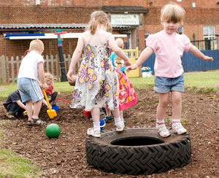
The Importance of Learning Through Play

Slide 2
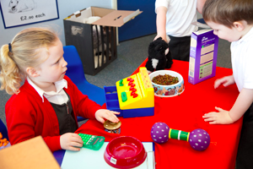
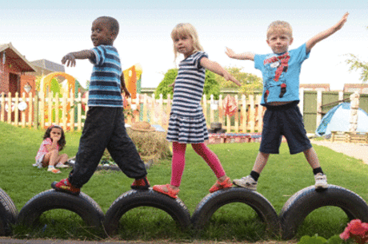
Why does early years education matter?
https://www.youtube.com/watch?v=XoOpfdQ6-G8&feature=youtu.be

Slide 3
10 PRINCIPLES OF EARLY YEARS EDUCATION Tina Bruce
The best way to prepare children for their adult life is to give them what they need as children.
Children are whole people who have feelings, ideas and relationships with others, and who need to be physically, mentally, morally and spiritually healthy.
Subjects such as mathematics and art cannot be separated; young children learn in an integrated way and not in neat, tidy compartments.
Children learn best when they are given appropriate responsibility, allowed to make errors, decisions and choices, and respected as autonomous learners.
Notes:
Tina Bruce is a leading figure in early childhood education and an expert on the principles of learning, she draws heavily on the work of the pioneers of child development work, Froebel, Steiner, Montesouri, Piaget, Bruner, Issacs through to more recent and current work by Vygotsky, Gardener, Nutbrown etc.

Slide 4
Self-discipline is emphasised. Indeed, this is the only kind of discipline worth having. Reward systems are very short-term and do not work in the long-term. Children need their efforts to be valued.
There are times when children are especially able to learn particular things.
What children can do (rather that what they cannot do) is the starting point of a child’s education.
Imagination, creativity and all kinds of symbolic behaviour (reading, writing, drawing, dancing, music, mathematical numbers, algebra, role play and talking) develop and emerge when conditions are favourable.
Relationships with other people (both adults and children) are of central importance in a child’s life.
Quality education is about three things: the child, the context in which learning takes place, and the knowledge and understanding which the child develops and learns.

Slide 5
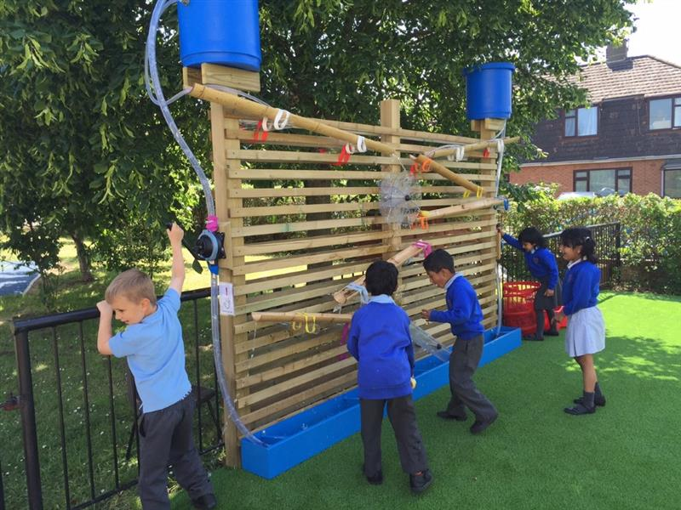
What are the key ways that young children learn?
playing
being with other people
being active
exploring new things and experiences
talking to themselves
communicating about what they are doing with someone who responds to their ideas
Notes:
playing
Playing – indoors and out, alone and with others, quietly or boisterously – allows children to find out about things, try out and practise ideas and skills, take risks, explore their feelings, learn from mistakes, be in control and think imaginatively. Playing is an important centre of learning for young children.
being with other people
As well as developing emotional security and social skills, being with other people – other children and adults – stimulates ideas and involvement that move learning forward.
being active
Young children need to move, and learn and remember things by taking experiences in through the senses as they move. Sitting still for too long can disrupt learning.
exploring new things and experiences
Children’s deep curiosity leads them to use all their senses to explore in real hands-on activities, and then put the information together in their own minds to form ideas and make sense of the world.
talking to themselves
In ‘self-speech’ children use out-loud thinking to clarify their thoughts, regulate their activities, take on imaginative roles and rehearse their skills.
communicating about what they are doing with someone who responds to their ideas
Even before they can talk in words, children are keen to share their ideas through sounds, gesture and body language. Talk helps children to understand what they experience. It is important that they have a chance to express their own ideas, as well as have conversations to hear other people’s ideas, extend their thinking, and use language about learning.

Slide 6
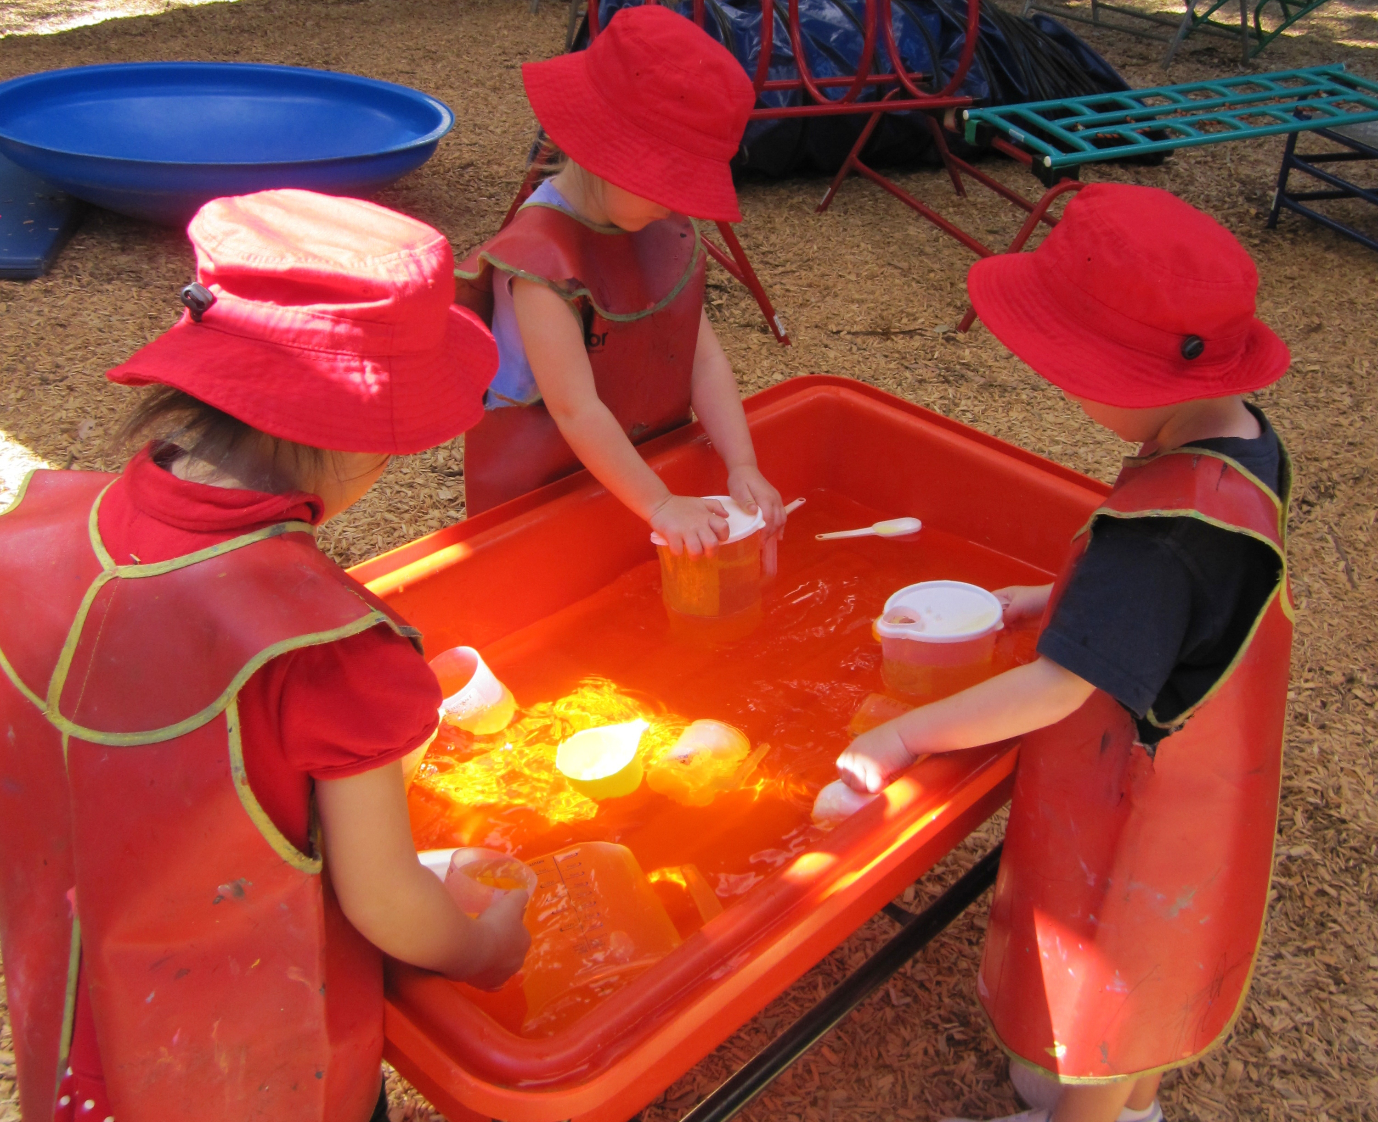
representing ideas and experiences
meeting physical and mental challenges
being shown how to do things
practising, repeating, applying skills
having fun
Notes:
representing ideas and experiences
Children deepen their understanding as they recreate experiences or communicate their thinking in many different ways – in role-play or small world play, pictures, movements, models, and talk.
meeting physical and mental challenges
Working out what to do, trying hard, persevering with problems, finding out and thinking for themselves are opportunities for developing real understanding. These challenges may occur in play, or in real-life or planned activities.
being shown how to do things
Children learn skills by watching others or being shown how to do something. Adults or peers may directly instruct, model, guide or demonstrate.
practising, repeating, applying skills
Rehearsing skills in similar tasks or new contexts helps children to build mastery, to enjoy their own expertise, and to consolidate what they can do.
having fun
There is no place for dull, repetitive activities. Laughter, fun, and enjoyment, sometimes being whimsical and nonsensical, are the best contexts for learning. Activities can be playful even when they are not actually play.

Slide 7
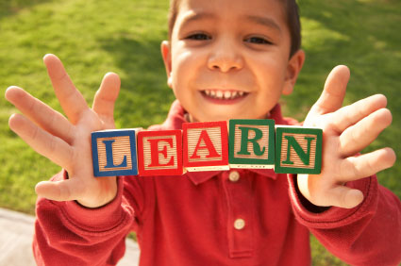
What is play?
Most importantly!!
Play is recognised as so important to their well-being and development that the right to play is set down in the United Nations Convention on the Rights of the Child (1989)

Slide 8
What is play?
Play is child-invented and child owned.
It is spontaneous.
It is free from externally imposed rules - it is entirely ‘goal-less’.
It has self-imposed goals.
It is personally and intrinsically motivated by the satisfaction of the activity itself.

Slide 9
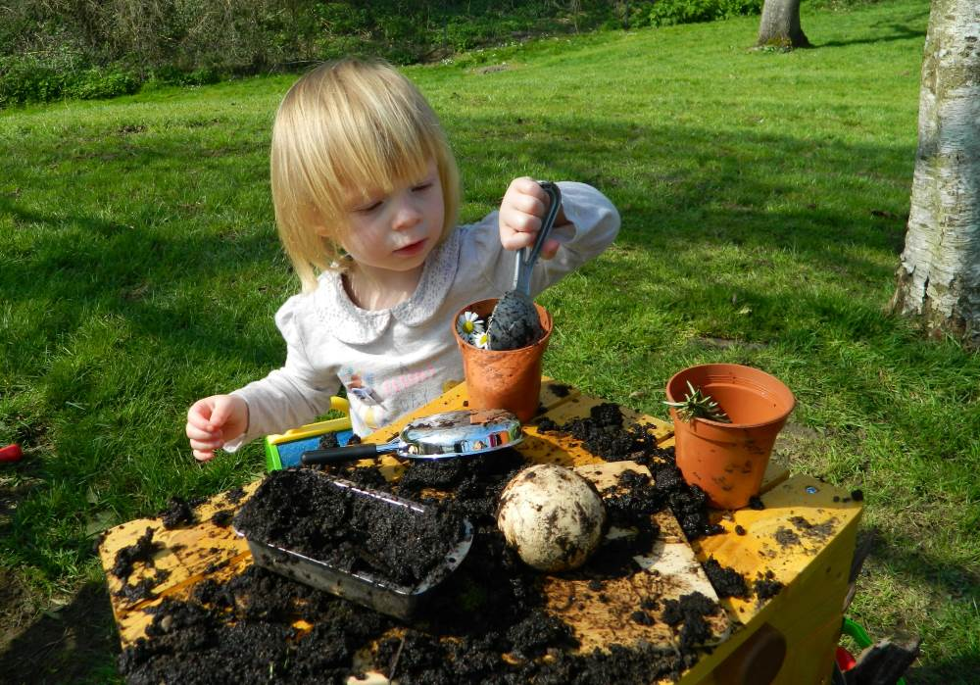
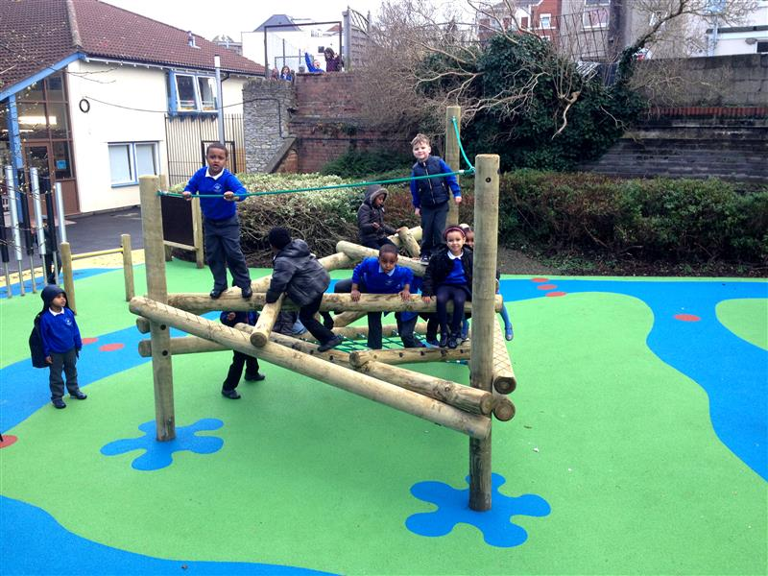
Differing types of play
Unoccupied play
Solitary play
Onlooker play
Parallel play
Associative play
Co-operative play
Notes:
Unoccupied Play
Unoccupied play refers to activity when a child actually isn't playing at all. He may be engaged in seemingly random movements, with no objective. Despite appearances, this is definitely play, and setting the stage for future play exploration.
Solitary (Independent) Play
Just what it sounds like – when your child plays alone. This type of play is important because it teaches a child how to keep himself entertained, eventually setting the path for being self-sufficient. Any child can play independently, but this type of play is the most common in younger children around ages two or three. At that age, they are still pretty self-centered, but lack of good communication skills. If a child is on the shy side and doesn't know his playmates well, he may prefer this type of play.
Onlooker Play
Onlooker play is when a child simply observes other children playing and doesn't partake in the action.
It's common in younger children who are working on their developing vocabulary. Don't worry if your little one is behaving this way. It could be that the child feels shy, needs to learn the rules or maybe is the youngest and wants just to take a step back for a while.
Parallel Play
Put two 3-year-olds in a room together and this is what you are likely to see: the two children having fun, playing side by side in their own little world.
It doesn't mean that they don't like one another, they are just engaging in parallel play. Despite having little social contact with her playmate, children who parallel play actually learn quite a bit from one another like taking turns and other social niceties, because even though it appears they aren't paying attention to each other, they truly are and often mimic the other one's behavior. As such, this type of play is viewed as an important bridge to the later stages of play.
Associative Play
Slightly different from parallel play, associative play also features children playing separately from one another, but in this mode of play, they are involved with what the others are doing – think children building a city with blocks. As they build their individual buildings, they are talking to one another and engaging each other. This is an important stage of play because it helps little ones develop a whole host of skills – socialization (what should we build now?) and problem solving (how can we make this city bigger?), cooperation (if we work together we can make our city even better!) and language development (learning what to say to get their messages across to one another).
Through associative play is how children begin to make real friendships.
Cooperative Play
Where all the stages come together and children truly start playing together. Common in older preschoolers (or in younger preschoolers who have older siblings or have been around a lot of children), cooperative play brings together all of thesocial skills your child has been working on and puts them into action. Whether they are building a puzzle together, playing a board game or an outdoor group game, cooperative play really sets the stage for future interactions as your child matures into an adult.

Slide 10
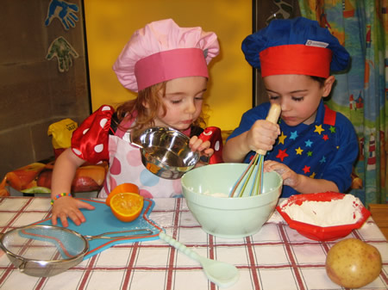
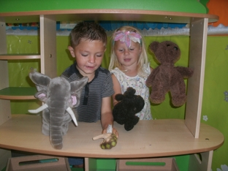
Other types of play
Dramatic play
Competitive play
Physical play
Constructive play
Notes:
Other Types of Play
While these stages are important and necessary for a child's social development, there are other types of play that also contribute to a child's maturity. These types of play usually develop as a child begins to engage in cooperative play and include:
Dramatic/Fantasy Play
Got a kid who loves to play dress up? How about "doctor" or "restaurant?" That's dramatic, or fantasy play. Through this type of play, not only does your child's imagination get a workout, but they learn how to take turns, cooperate, share and work on language development. Through role play, kids are also able to learn about functioning in the greater community.
Competitive Play
Whether she's beating her brother at Chutes and Ladders or playing on a local soccer team, your child is engaging in competitive play. Rules and turn taking, and functioning as part of a team are the big lessons taken from this type of play. You may have to give your child guidance about dealing with both winning and losing.
Physical Play
Gross and fine motor skills really come into play here, whether your child isthrowing a ball or riding a bike. Physical play encourages kids to be active.
Constructive Play
Forms of constructive play include building with blocks, making a road for toy cars or constructing a fort out of couch pillows. Constructive play teaches kids about manipulation, building and fitting things together. Cognitive skills are used to figure out how to make something work best, whether it is a block tower that won't stand up or a sand castle that keeps collapsing.

Slide 11
The importance of play
https://www.youtube.com/watch?v=h_-1O_rBLPU&feature=youtu.be

Slide 12
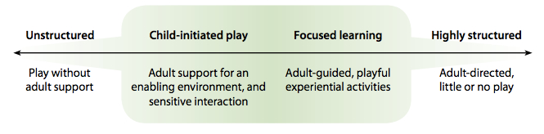
How to enable play
Notes:
At one end, too little adult support can limit learning. While play without adults can be rich and purposeful, at times it can become chaotic or repetitive activity which is ‘hands-on, brains-off’. At the other end of the scale, too much tightly directed activity deprives children of the opportunity to engage actively with learning. Effective Early Years practitioners will organise the time, space and activities in the daily routine to reflect the overall combination which best supports children’s well-being and learning.

Slide 13
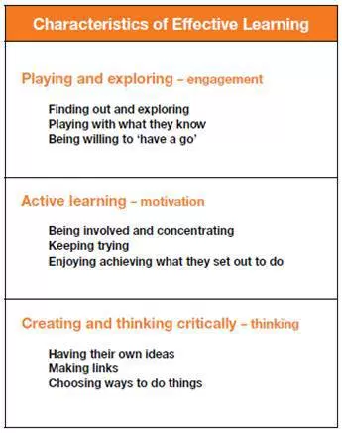
Characteristics of effective learning

Slide 14
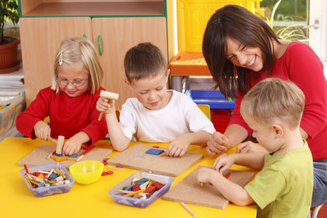
How can adults support play?
https://www.youtube.com/watch?v=sWf6oHE9YqY
Notes:
5-10 minutes

Slide 15
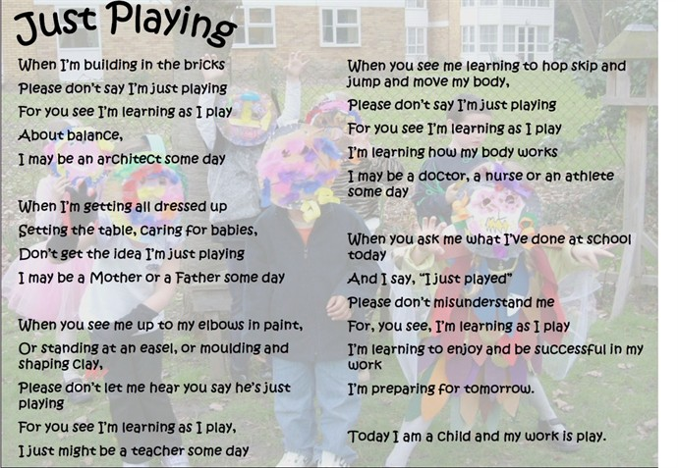
Poem – Anita Wadley 1974

Slide 16
Any questions?
https://charlottesmythe.wordpress.com/2014/04/08/play-why-is-it-so-important/
https://www.stonebridge.uk.com/blog/early-years-and-child-care/let-the-children-be-children-play-and-child-development

