Slide 1

St Joseph’s Catholic Academy
“Together we grow in God's love, learning to be the best we can be”.

Slide 2
Welcome to Year 1
Teachers:
Miss Loveitt (Monday - Thursday)
Mrs Cannon (Friday)
Teaching Assistants: Mrs Hacksley and Mrs McCaw

Slide 3
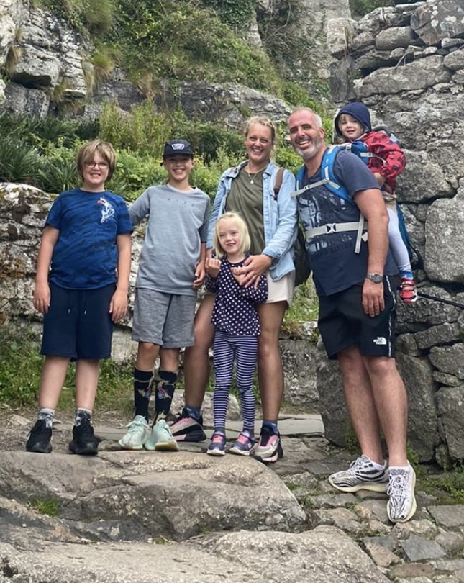
About me… Miss Loveitt
This is my 4th year teaching at St Joseph’s.
Middle Lead/ ART, DT and Music lead for the school.
Passionate about art, creativity in learning and building positive, supportive relationships with parents.
My aim is to make sure all children are happy, secure and feel ready to learn.
I have four children of my own, 16 year old twins, a 10 year old and a 7 year old.
In my spare time I love painting, reading and cooking!

Slide 4
Parent – Teacher partnership
You have made a positive choice in sending your child to St. Joseph’s. Our commitment is to promote excellent learning and behaviour.
For your child to reach their full potential we need to work together.
Communication, consistency, collaboration.
This might mean:
supporting the school in managing your child’s behaviour.
set a good example and promote positive behaviour at home.
keep us informed of behaviour difficulties your child may be experiencing at home.
inform the school of any kind of trauma which may affect your child’s mental health at school.
Contact the class teacher if you feel that your child’s behaviour, in or out of school, is impacting on your child’s emotional well-being.
Child
Success
Parents
Teachers

Slide 5
Attendance and Punctuality
Good attendance at school is proven to be significantly linked to progress.
Gate opens at 8.45 and we finish at 3.15
Soft start – activities focused on individual or class targets
Registration is between 8:45 and 9:00
Illnesses – informing school on the days of absence
Attendance policy – leave of absence.

Slide 6
Year 1 is important because…
The children become more independent learners
They continue to progress in all areas but often learners become much more confident readers and writers during year 1
First year of key stage one
Children will become experts at phonics and will take a phonics screening test in the summer term.
Really exciting topics – Dinosaur Planet, Ice Kingdom, Fire, Fire and more!

Slide 7
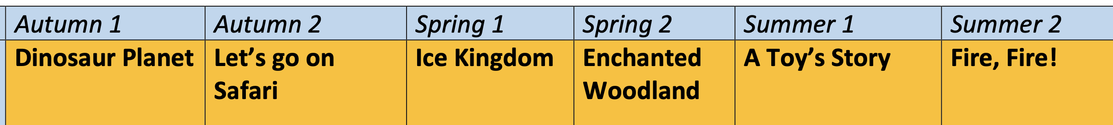








Year 1 Curriculum topics

Slide 8
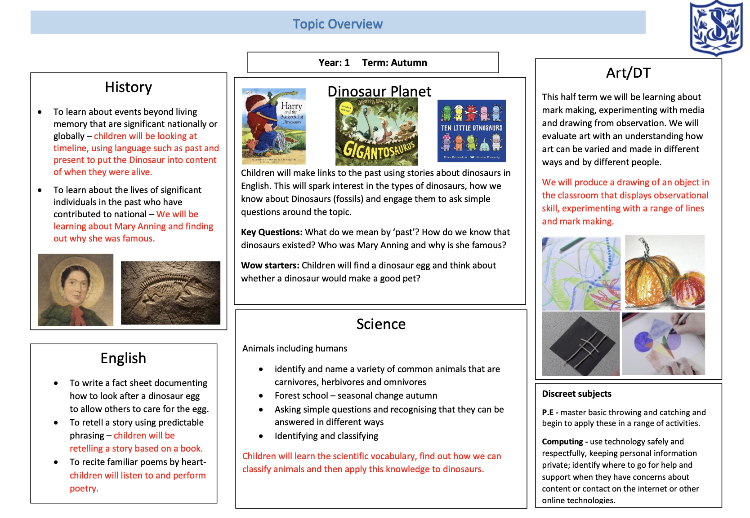
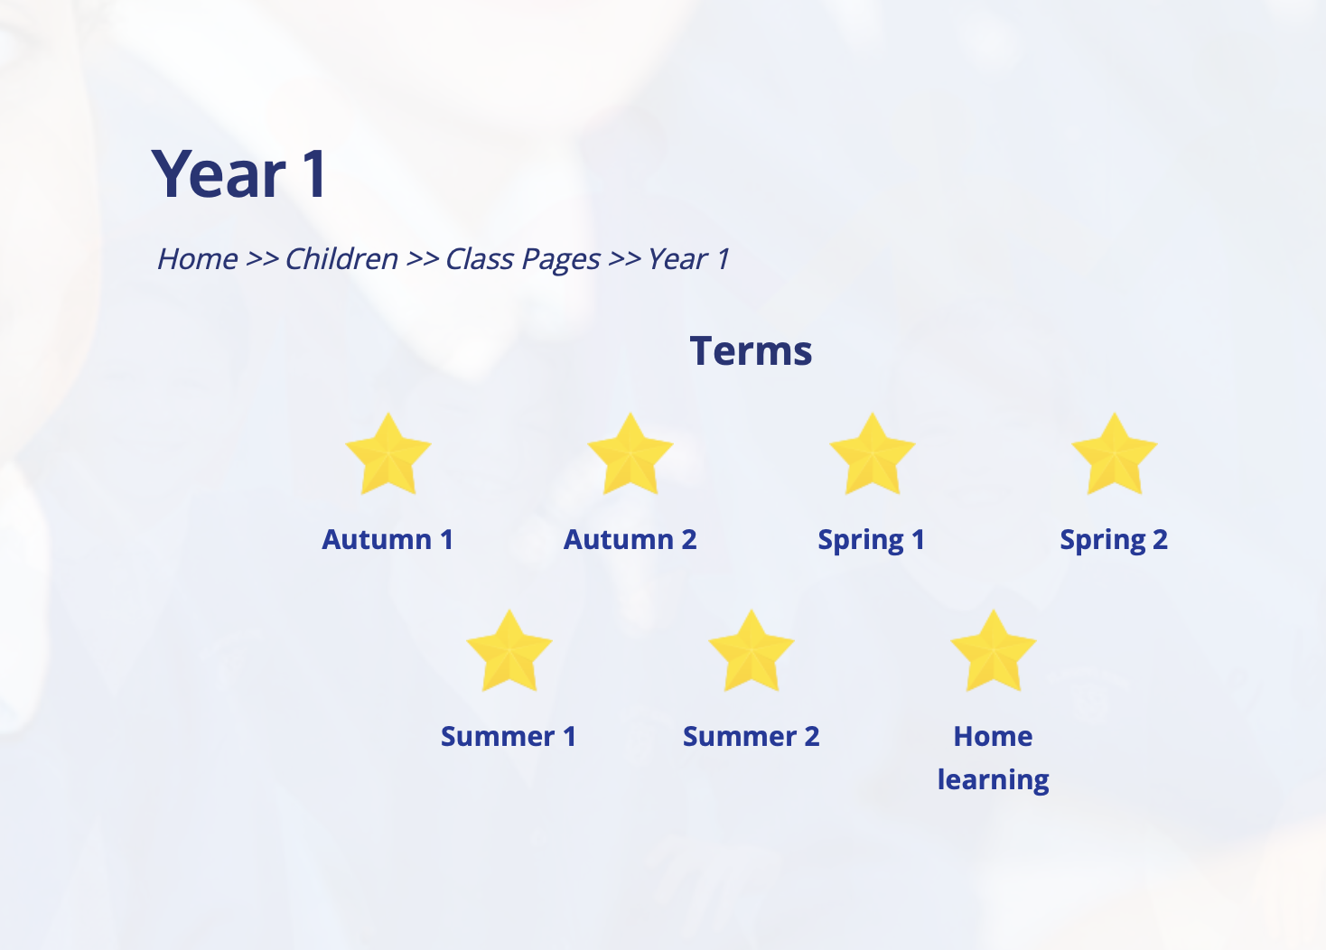
Topic half term overview
You can find a topic overview on your class webpage as well as other helpful documents/links.

Slide 9
Classroom routines
Please make sure that your child has a water bottle and afternoon snack everyday (morning fruit is provided.)
Monday – swimming (3 weeks)
PE – Monday
Thursday – Home reading book returned and changed.
Monday- forest school – Wellies can be kept in school. Please wear school top and navy joggers/leggings to school.

Slide 10
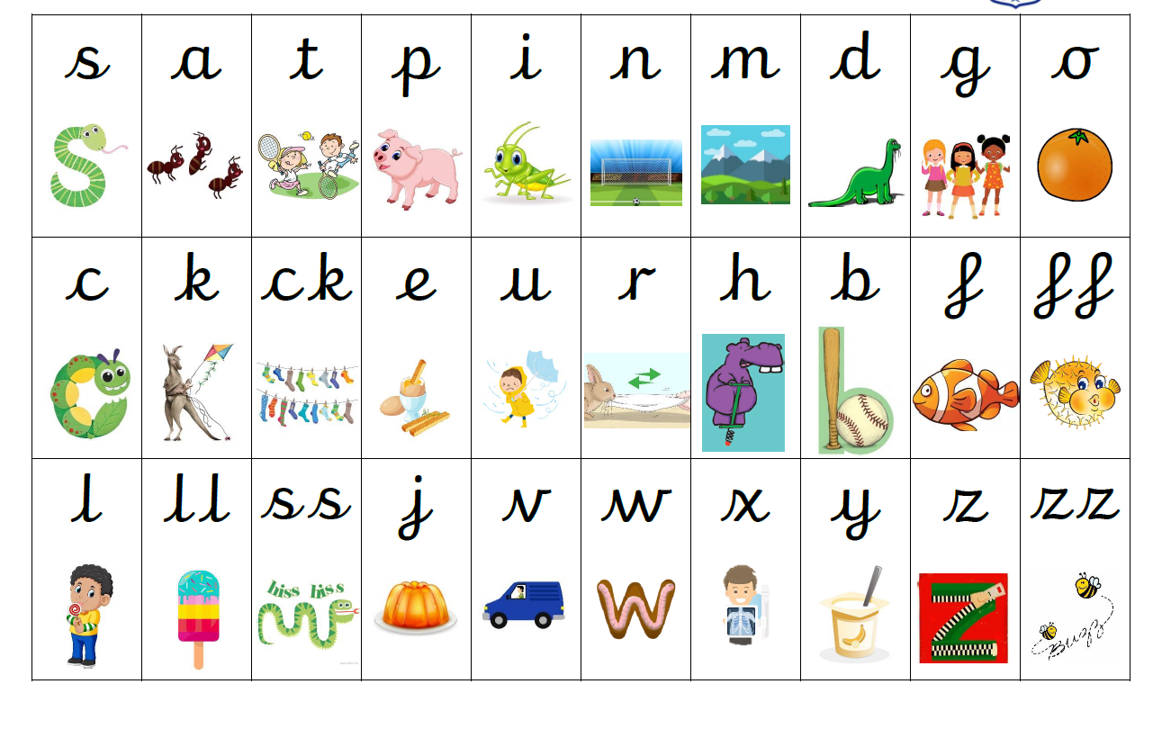
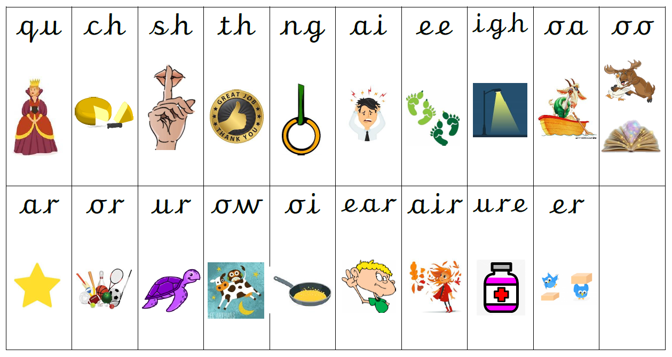
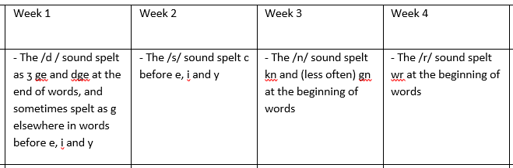
Phonics
Recap phase 3/4 sounds during Autumn 1
Children will use sound mats and phonics skills learnt in Reception.
Will move onto phase 5 in Autumn 2
Children who need additional support with phase 3/4 will receive intervention.

Slide 11
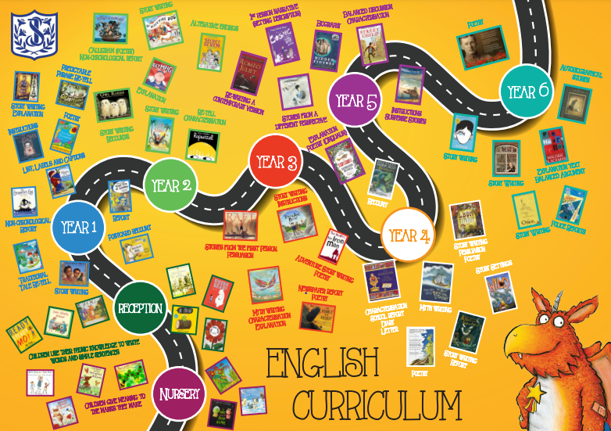
English – text based curriculum

Slide 12
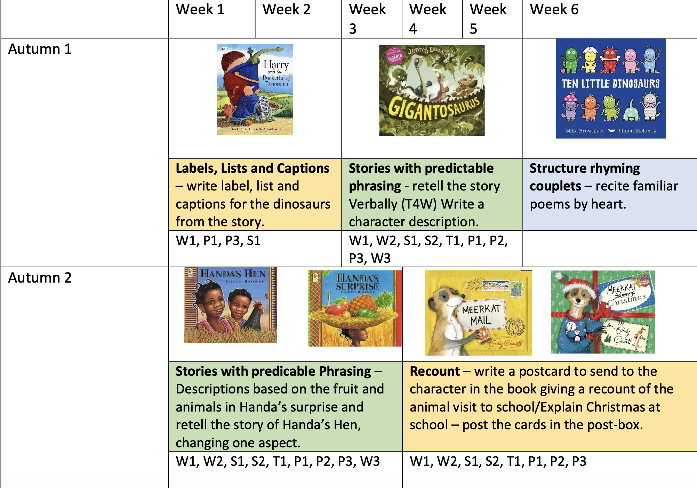
English
Writing is taught with a book based approach to make it exciting and engaging.
This half term we will be focusing on writing labels and captions, retelling z story verbally and describing characters. Will will also be working hard to secure the use of capital letters for the start of a sentence, names and places.
Reading is taught through shared and guided reading and individual reading.
Your child will read at least once a week with an adult.

Slide 13
Maths
We teach Maths using a maths mastery approach.
We will use concrete, pictorial and abstract methods to help the children develop a deep understanding of mathematical concepts.
Maths will be taught using a whole class adult input, including guided practice which allows children to have a go at the concept being taught with guidance from the teacher. This build’s confidence and helps the teacher to assess understanding. This is followed by a mixture of independent tasks, challenges and adult led groups to consolidate understanding.
This half term we will focus on composition of numbers, learning how to count to 100 and beyond, count collections of objects efficiently by making groups of ten and representing numbers 20-100 using base 10 equipment. Eventually moving on to partitioning and addition and subtrtaction of tens and ones.

Slide 14
RE
We teach RE for 10% of our timetable.
We carry out a daily act of worship in class or during our whole school assemblies.
We also include a morning, lunch and end of day prayer in our daily routine.
Termly liturgies will be taking place this year. The children will be inviting parent to join these.

Slide 15

How can you help your child? Home learning.
Listen to your child read at home every day for at least 10 minutes. Also read and share books with your child.
Look for opportunities to write for a purpose e.g. thank you cards, postcards, instructions, menus etc.
I will set:
Maths fluency sheet – linked to our learning in class.
Spelling challenges (at their own pace)
Topic - Purple Mash if appropriate.

Slide 16
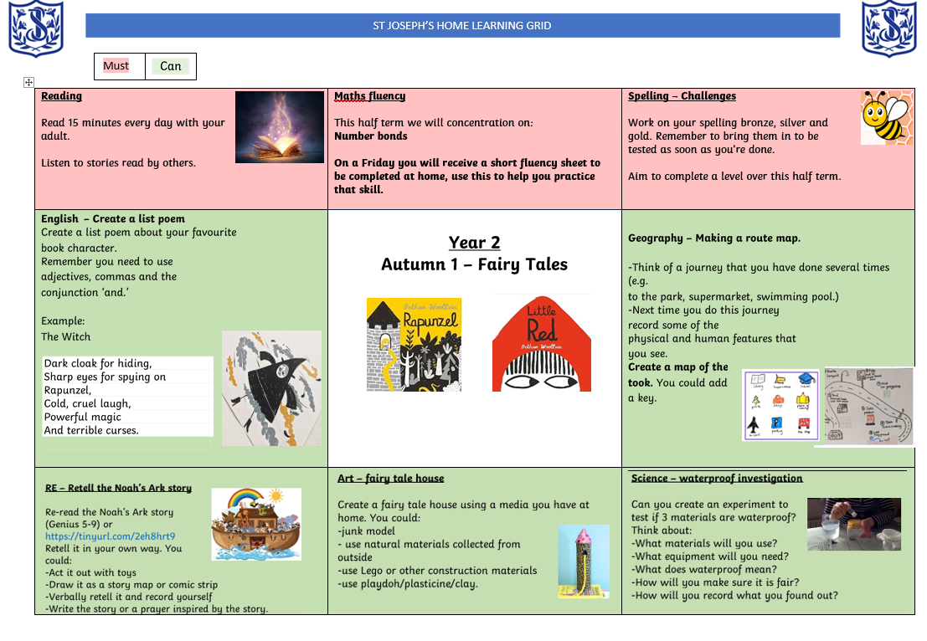
Maths fluency is a collection of key skills that help children build their mathematical knowledge and make learning new skills easier. Developing quick and accurate recall of these skills gives children a strong foundation for their maths learning.
Some important fluency skills include:
Number bonds
Times tables
Mental and arithmetic skills
Each Friday, your child’s class teacher will send home a short fluency skill to practise. The accompanying sheet is designed to provide a simple prompt for practising this skill at home.
If your child finds the skill tricky, don’t worry! Additional practice can be helpful. This could include using times-table songs, games, practical activities or other fun ways to practise.
Thank you for supporting your child with their maths fluency at home!

Slide 17
Why is it so important to read with your child?
Reading for pleasure is the single biggest indicator of a child’s future success – more than their family circumstances, their parents’ educational background or their income.
-organisation for Economic Co-Operation and Development
Students are less able to learn other curricula if they do not develop sufficient reading skills by the middle of primary school.
- [DfE (2016) DfE strategy 2015-20: World-class education and care p.24]
Children who read books often at age 10 and more than once a week at age 16 gain higher results in maths, vocabulary and spelling tests at age 16 than those who read less regularly.
-OECD (2010) PISA 2009 Results: Learning to Learn: Student Engagement, Strategies and Practices p. 32-4]
Participation in shared reading groups is linked to enhanced relaxation, calmness, concentration, quality of life, confidence and self-esteem, as well as feelings of shared community and common purpose
-[Longden E., Davis P., Billington J., et al (2015) Shared Reading: Assessing the intrinsic value of a literature-based intervention Medical Humanities, 41 (2), pp. 113-20]
Studies have found that reading for pleasure enhances empathy, understanding of the self, and the ability to understand one's own and others' identities.
Studies have shown that those who read for pleasure have higher levels of self-esteem and a greater ability to cope with difficult situations. Reading for pleasure was also associated with better sleeping patterns
[Billington, J, (2015)Reading between the Lines: the Benefits of Reading for Pleasure Quick Reads University of Liverpool]

Slide 18

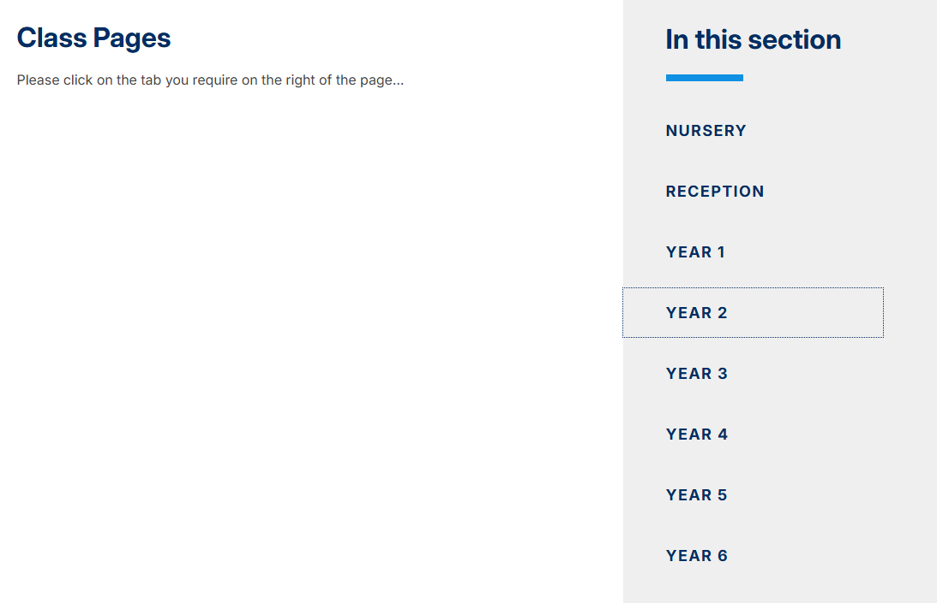
School website
Our class page will be updated throughout the year with pictures, letters and information.

Slide 19
Communication
If appropriate some messages can be given on the gate at drop off or collection time.
Please feel free to email the office and I will call you or email back as soon as possible.
Instagram – the office will update our school Instagram with messages, reminders and any useful information.
Newsletters/news bulletin –biweekly newsletters will keep you up to date with upcoming events and will also give you a snapshot of what has been happening in school.
Weekly Blogs – see next page

Slide 20
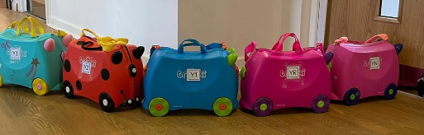
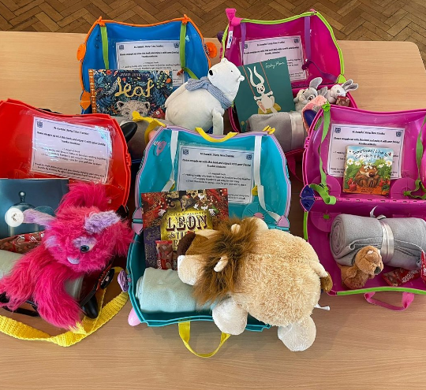
Trunki
Children in Nursery to year 4 will have the opportunity to take the class Trunki home during the school year.
This aims to encourage reading for pleasure
Trunki contains an exciting, age appropriate picture book
Blanket
Cuddly toy
Hot chocolate
Take Trunki home on a Friday and bring it back by the following Thursday.

Slide 21
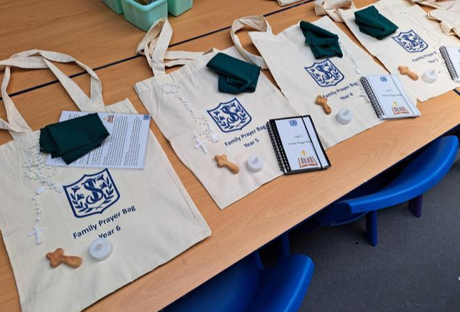
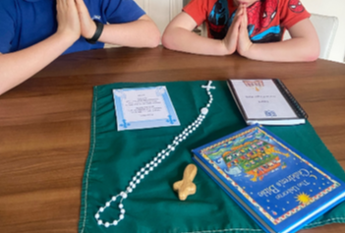
Prayer Bags
Each child will have an opportunity to take home the class prayer bag
This contains everything you need to carry out a collective worship at home, in the same format as the children do in school
There is an information card inside the bag and a video on our school website to guide you, if needed https://www.stjosephs255.herts.sch.uk/worship-at-home/
Teachers will start by sending home the bag with children who didn’t get a turn last year. This is due to the prayer bags been introduced late in the year.

Slide 22
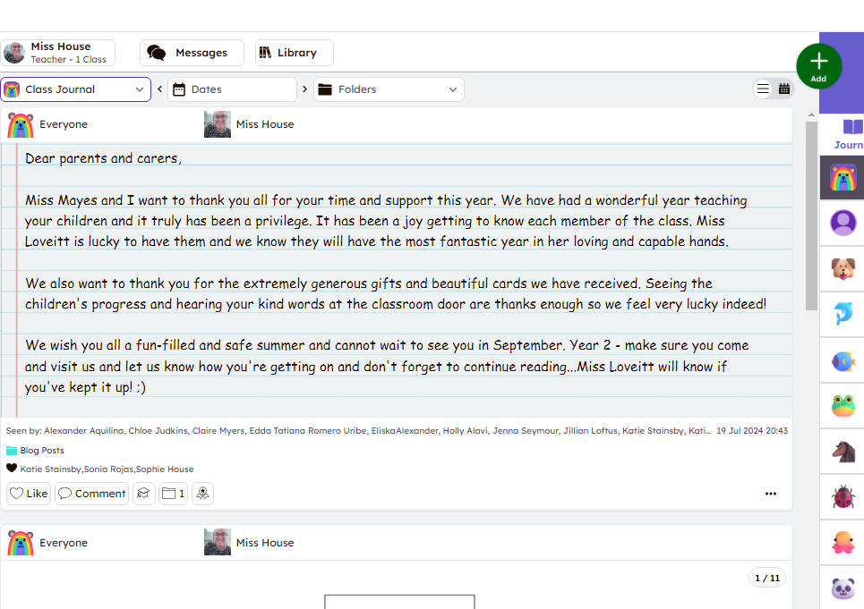

Weekly Blog
Keep up to date with all your child’s learning with Seesaw!
There will be a weekly blog every Friday about the learning from the week. We will also update you with anything you can discuss or practice with your child to prepare them for the week ahead.
-Make sure you have linked with your child’s new class using your new log in (have already been sent home, let me know if you need another copy.)
-The children will get their logins, so they can upload things at home, later this half term.

Slide 23

Any questions?

